Slide 1
NIRISS Calibration Working Group Activities
JWST FGS
Kevin Volk
STScI / HIA
NIRISS Science Team Meeting
Montréal, 2015 October 20/21

Slide 2
Calibration WG Activity 2014/2015
The main calibration milestone was the delivery of the Calibration Reference files (CDP1) to the pipeline group at STScI--nominally via GSFC--in May 2015
Calibration Plan document (OPS-03B) draft delivered in fall of 2014; that draft is currently being updated to be consistent with the Operations Concept Document
Selection of replacement detector and subsequent analysis of the COM DEV detector test data from fall 2014/spring 2015 (the latter for the flight spare)
CV3 planning inputs from the Calibration Working Group to André for making the NIRISS testing plan
SOSS level 2a to 2b algorithm delivery package almost ready to forward to the STScI pipeline group

Slide 3
Anticipated Work 2015/2016
CV3 support late 2015/early 2016
Analysis of CV3 data for CDP2 delivery (due 6 months after the end of CV3); this is extremely important since there will not be much opportunity to get data in the OSIM testing except possibly for dark ramps
Finalization of all pipeline algorithms
The calibration plan document revision should be finished sometime after CV3
We may need to determine specific on-orbit targets for various calibrations (for consistency with the commissioning CARS)

Slide 4
Current Reference Files (1)
Detector Calibrations (from darks or illuminated frames)
Dark current ramps
Pedestal images
Bad Pixel masks (lots of work by Chris….)
IPC measurements
Cross-Talk measurements and characterization
Read Noise and 1/f noise properties
Gain measurements
Persistence measurements (from COM DEV testing)
Linearity characterization
Saturation measurements (from Teledyne testing)
All to be determined in CV3 unless noted otherwise

Slide 5
Current Reference Files (2)
Filter and Grism Calibrations (some from theory only)
Illumination Flats for filters
Pixel Flats for filters
Occulting spot characterization by filter
Grism trace measurements
Grism wavelength calibration (CV3 will give limited data)
Filter to Filter offsets in imaging
Astrometric distortion
Pixel area map
Background estimates
Photometric calibration

Slide 6
Current Simulation Work
As a bi-product of revising the calibration plan, I am working on the details of some of the proposed calibration observations
The astrometric calibration observation planning requires a simulation to see what the bar of the LMC will look like at the NIRISS angular resolution and sensitivity
Ditto for WFSS for the proposed wavelength calibration using the planetary nebula SMP LMC 58
Sherie Holfeltz is helping with the WFSS simulations
Background and sensitivity/photometric simulations are ongoing

Slide 7
Deep Simulations
For WFSS, 340000 sources to F606W=27 (type K5V at the LMC)
For imaging, 1.65 million sources to F606W=30 (type M5V at the LMC)
Use F606W and F606W – H to get H-band magnitudes
Use different spectral types as a function of F606W and F606W – H to get NIRISS brightness estimates for different filters
Random distribution of stars within the field of view
WebbPSF used for the PSFs in the simulations
This is a BIG star count extrapolation from the existing HST data, with corresponding overall uncertainties

Slide 8
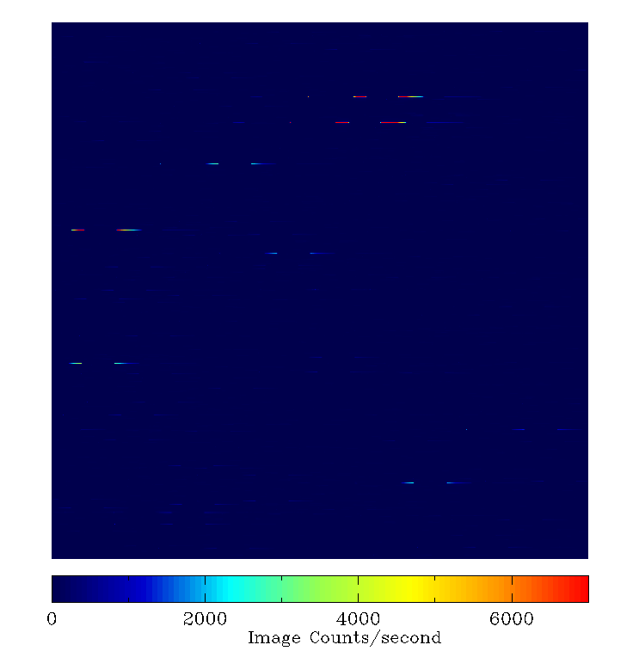
WFSS simulation
linear
full frame F090W

Slide 9
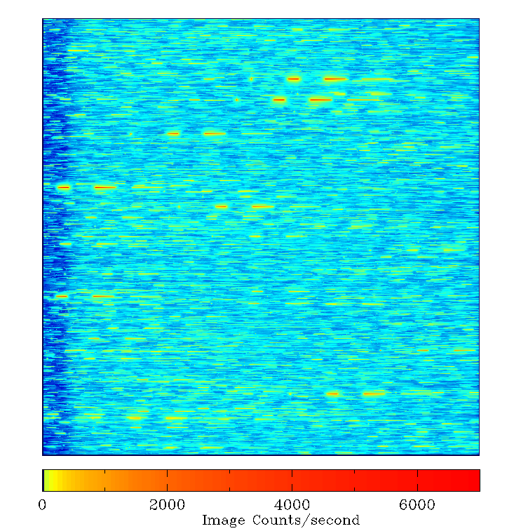
logarithmic

Slide 10
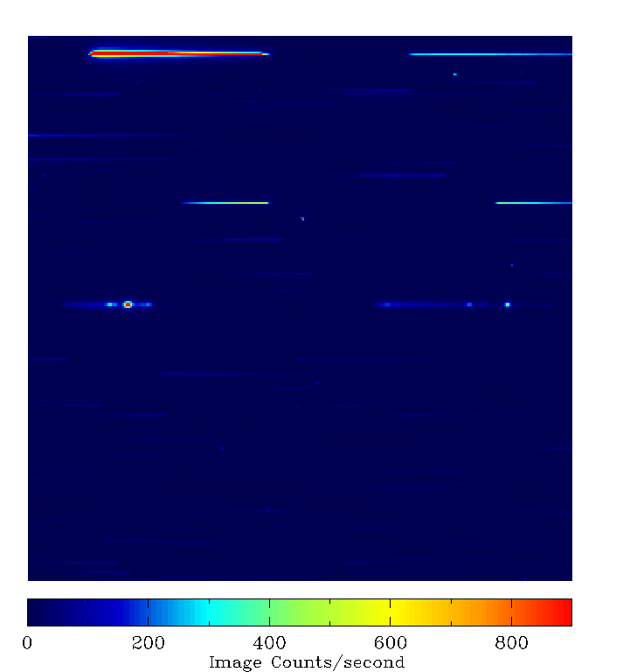
linear
zoomed in 300×300 pixels

Slide 11
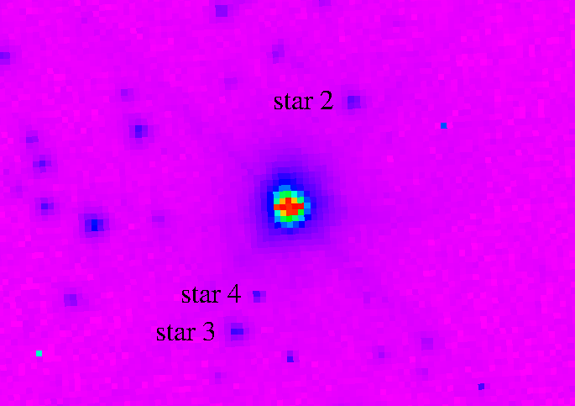
STIS Image
SMP LMC 58
V ~ 21.8
1 arc-second

Slide 12
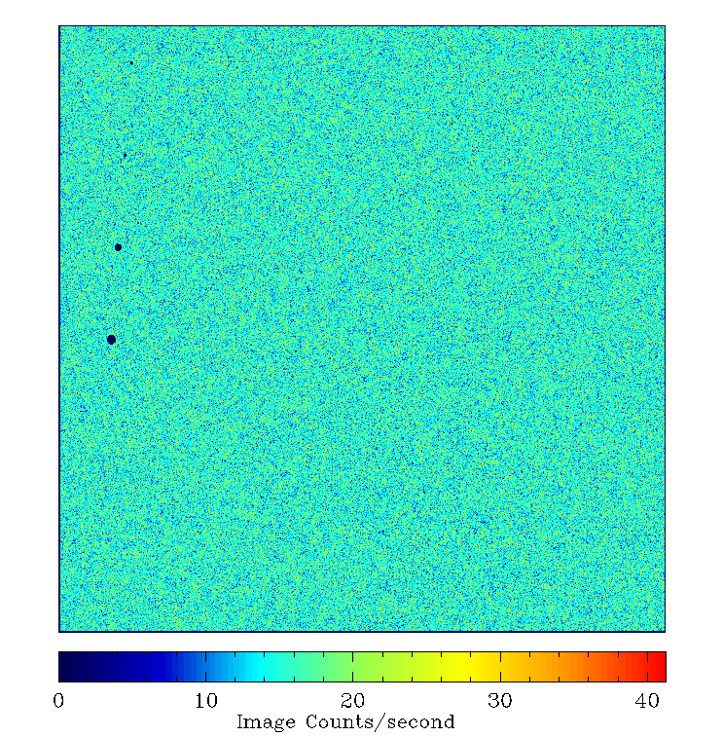
F090W imaging simulation
(faintest 10 million stars) full frame

Slide 13
F090W imaging simulation
(all stars) full frame

Slide 14
F090W Simulation Pixel Histogram

Slide 15
F444W Simulation Pixel Histogram

Slide 16
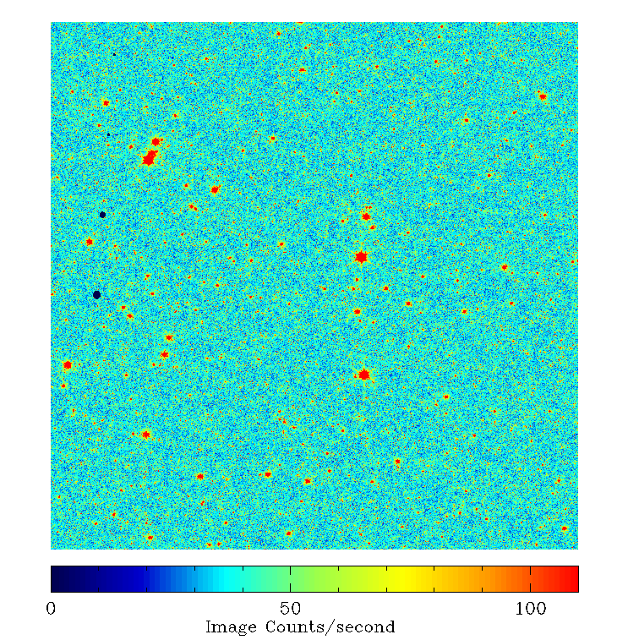
F090W imaging simulation
(all stars) full frame, log scale, range from histogram 5σ range

Slide 17
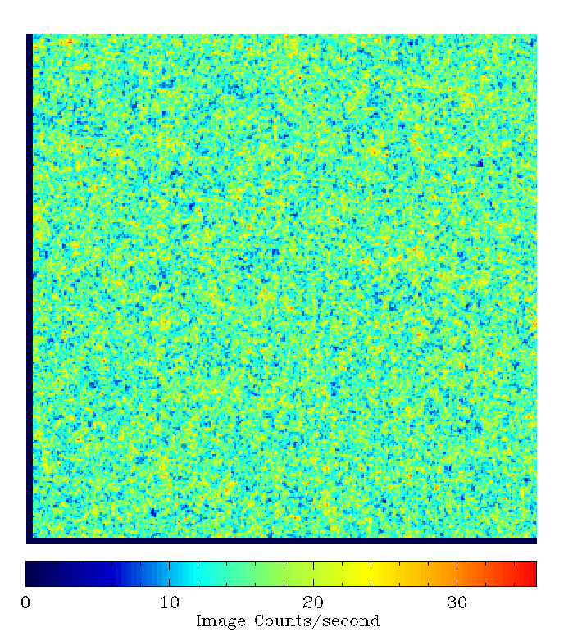
F090W simulation
(faintest 10 million stars) 300×300 pixels, lower left corner

Slide 18
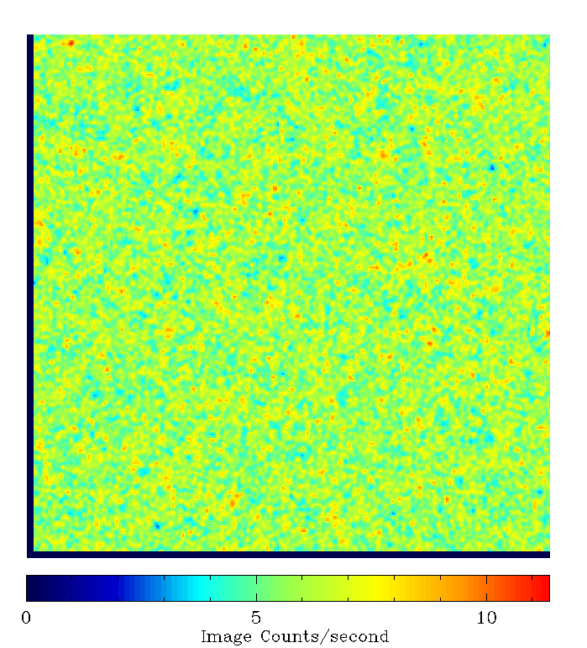
F444W simulation
(faintest 10 million stars) 300×300 pixels, lower left corner

Slide 19
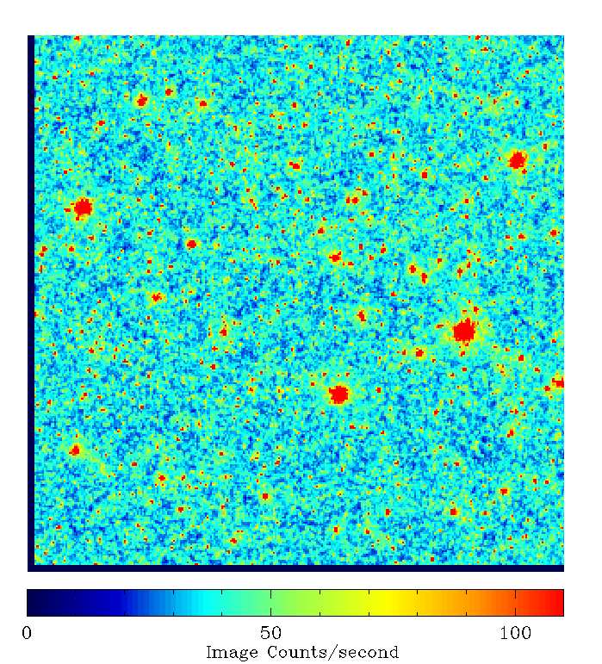
F090W simulation
(all stars) 300×300 pixels, lower left corner

Slide 20
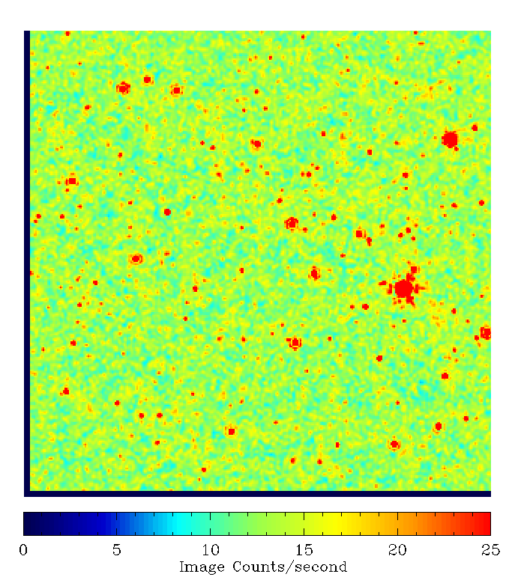
F444W simulation
(all stars) 300×300 pixels, lower left corner

