Slide 1
Assessing the binarity of a PMO 2pc from the Sun
Étienne Artigau

Slide 2
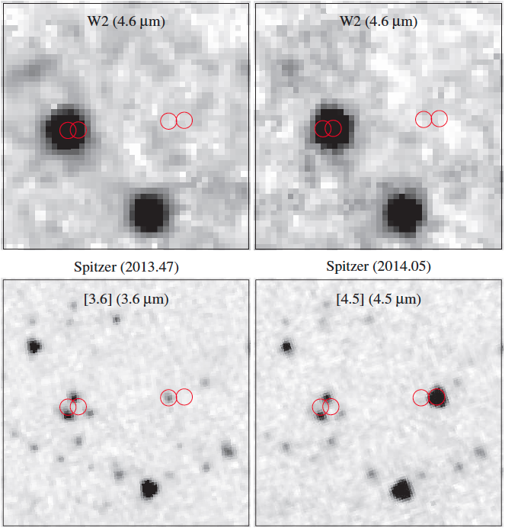
WISE0855
Thirrd fastest moving non-SS object in the sky
  >8”/year
Uncovered in multi-epoch WISE data, exceedingly faint in the near-infrared
Faint in WISE bandpasses : W2=13.9, undetected in W1 (!)
Astronometric follow-up : distance of 2pc
  third object after αCen system and Barnard’s star!
Exceedingly faint in the near infrared
  Marginally detected after 8h of J-band Magellan observations… J=25 or M_{J}=28.5

Slide 3
What is that beast?
Free-floating brown-dwarf-like object that is exceedingly cold
  250 K (mid-winter Montreal)
    Most-likely covered with snow storms
  All that we know comes from J+[3.6]+[4.5] flux measurements
  Much cooler than any known non-SS object, including Y dwarfs
The Universe is too young for this not to be a planet… models predict a 3-10 M_{jup} mass.
Brown dwarfs don’t get that cold in 13 Gyr…

Slide 4
What is that beast?
WISE0855 will (most likely) be one-of-its-kind in the study of extrasolar planets
  Similar objects will, one day, be uncovered but they will be next-to-impossible to study
  True mass may be determined in the not-so-distant future
Obvious target to detailed characterization with JWST
No significant contribution from ground-based facilities, even ELTs

Slide 5
What is that beast?
JWST follow-ups
  NIRSpec prism <2.5µm at moderate SNR
  NIRSpec+MIRI high-resolution spectroscopy at very good SNR
Evolution of cloud patterns
  Ongoing SPITZER time-resolved photometry could reveal (snow?) storms on its surface
  Time-resolved >3µm spectroscopy possible with NIRSpec at high resolution to detect sub-% variability

Slide 6
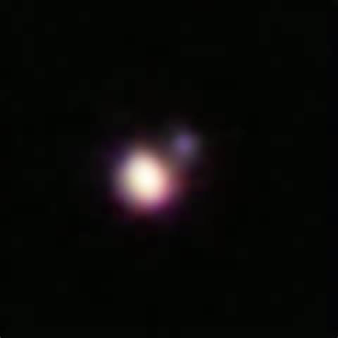
What is that beast?
After SED characterization, one question will linger :
  Is this a binary planet?
Unique object, unique opportunity to better know a cold super-Jupiter planet…
Overlooked binarity could lead to a major misunderstanding of energy budget
Binary brown dwarfs are common (occurrence in the tens of percent but census largely incomplete) and are generally tight (<2 AU)

Slide 7
What is that beast?
Near-infrared flux falls exceedingly fast at this temperature
  Loss of 0.6 to >1 mag per 10°C in that temperature range!
Lets assume a 250K+200K binary with a 0.1 AU separation
  Companion 4 mags fainter in J
    98%/2% contribution to J-band flux
  Companion 1.2 mag fainter at [4.5]
    75%/25% contribution to [4.5] flux

Slide 8
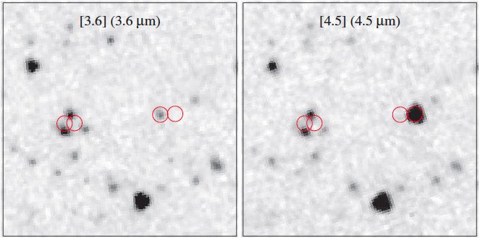
NIRISS GTO
~F380M
~F480M
Binarity assessment must be performed >3µm
What is the highest angular resolution mode >3µm on JWST?
  NIRISS+AMI of course!
F380M/F430M/F480M color very interesting
  Strong constraint on temperature of companion
10-σ detection limit
180s open-shutter

Slide 9
NIRISS GTO
Null result would simplify modeler’s life
A null result would not exclude sub-Jupiter mass planets
  No impact on overall SED determination
Orbits probed would be as short as 1 year
Astrometric monitoring to rule closer-in companions?

